Slide 1
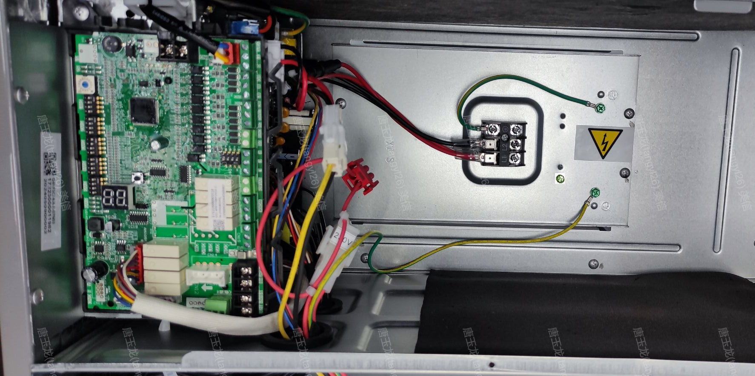
Remove the fixing screws of the terminal block, the grounding screw of the terminal block (if there is), and remove the fixing screw of the motor grounding wire (if there is)

Slide 2
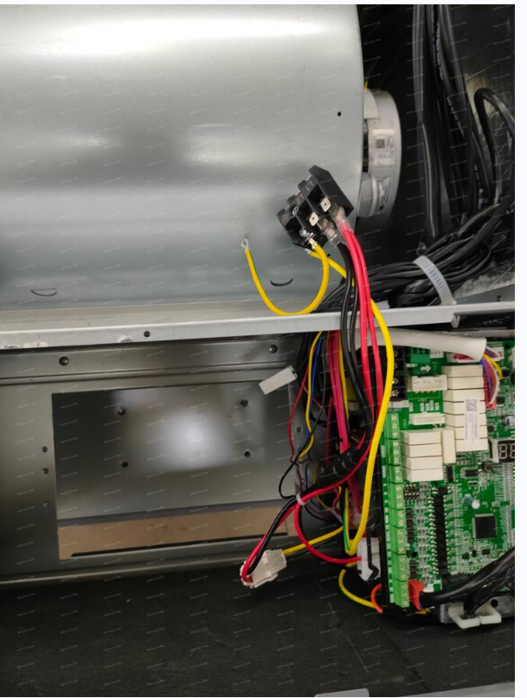
Keep the terminal block and the cable, DO NOT THROW AWAY.

Slide 3
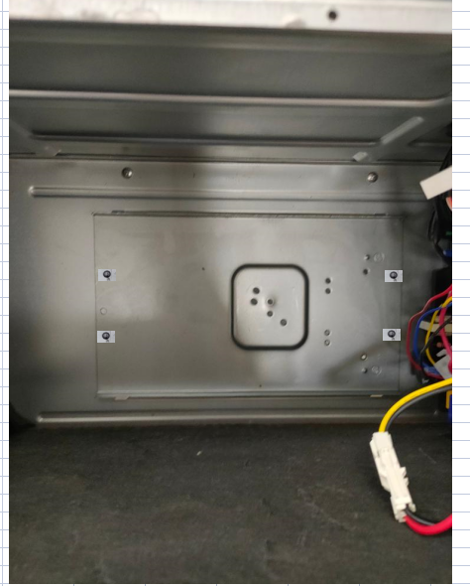
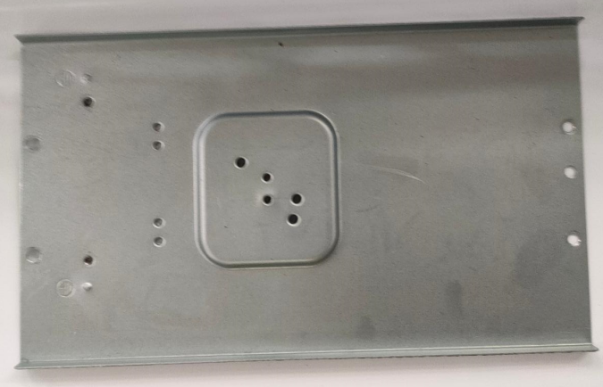
Remove the screws from the Cover and remove the cover

Slide 4
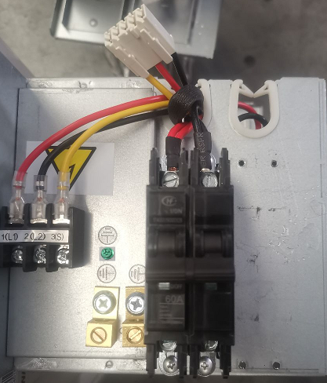
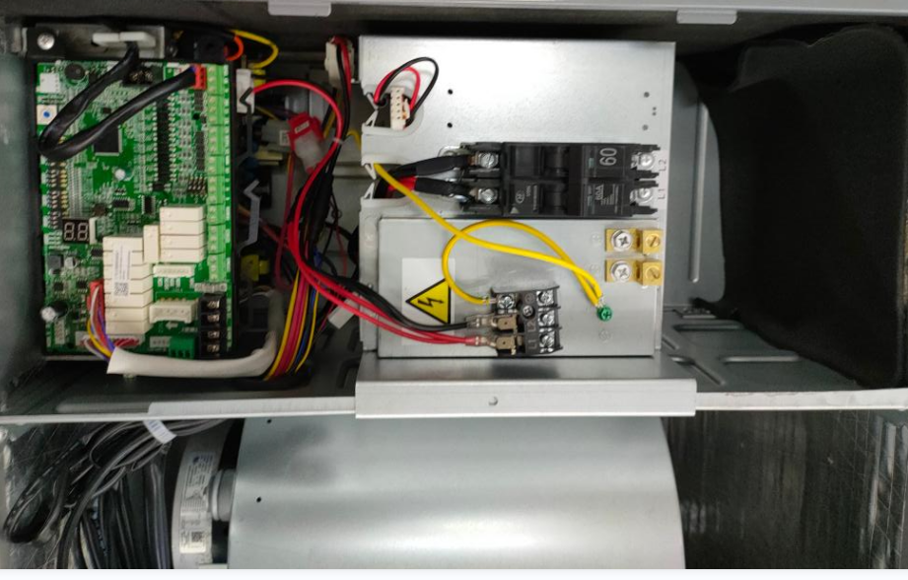
Heater example
Remove and dispose the wiring terminal block & wire from the electric heater kit
Fix the wiring terminal (the one comes with the indoor unit) on the new cover(the one comes with electric heater) ,fix the grounding wire of the terminal block (if there is) and the grounding wire of the motor on the electric auxiliary heating cover(if there is)

